Slide 1


Python String Operations: Indexing, Slicing & Methods
A practical guide for students learning to work with text in Python.

Slide 2

Why Strings Matter in Python
Everywhere in Code
Powerful Built-in Tools
Strings are one of the most-used data types — text, user input, file content, web data
Python gives you built-in methods to slice, search, and transform strings with ease
Real-World Skills
Mastering string operations unlocks practical programming tasks from day one

Slide 3




String Indexing: Accessing Individual Characters
Each character in a string has a position (index) starting at 0.
Positive Index
Negative Index
word[0] → first character
word[-1] → last character
Think of indexes like house numbers on a street — every character has its own address!

Slide 4

String Slicing: Extracting Substrings
Grab a portion of any string using the slice syntax: string[start:stop:step]
Stop
Exclusive index where slicing ends.
Start
Step
Inclusive index where slicing begins.
Stride determining which elements to skip.
Basic Slice
Reverse a String
"Python"[0:3] → "Pyt"
"Python"[::-1] → "nohtyP"
Remember: start is inclusive, stop is exclusive.

Slide 5



Cleaning Text: strip()
Removes leading and trailing whitespace — or any specified characters.
" hello ".strip() → "hello"
" hello ".lstrip() → "hello "
" hello ".rstrip() → " hello"
lstrip()
Strips from the left side only
rstrip()
Strips from the right side only
Essential for cleaning user input and data read from files.

Slide 6





Changing Case: upper(), lower(), title()
upper()
"hello".upper() → "HELLO"
Converts every character to uppercase.
lower()
"WORLD".lower() → "world"
Converts every character to lowercase.
title()
"python is fun".title() → "Python Is Fun"
Capitalizes the first letter of each word.
Useful for normalizing input before comparisons — e.g. convert to lowercase before checking equality.

Slide 7


Swapping Text: replace()
How It Works
Replaces all occurrences of a substring with another string.
"I like cats".replace("cats", "dogs")
→ "I like dogs"
An optional third argument limits the number of replacements:
"aaa".replace("a", "b", 2)
→ "bba"
Without the third argument, every match is replaced throughout the entire string.

Slide 8
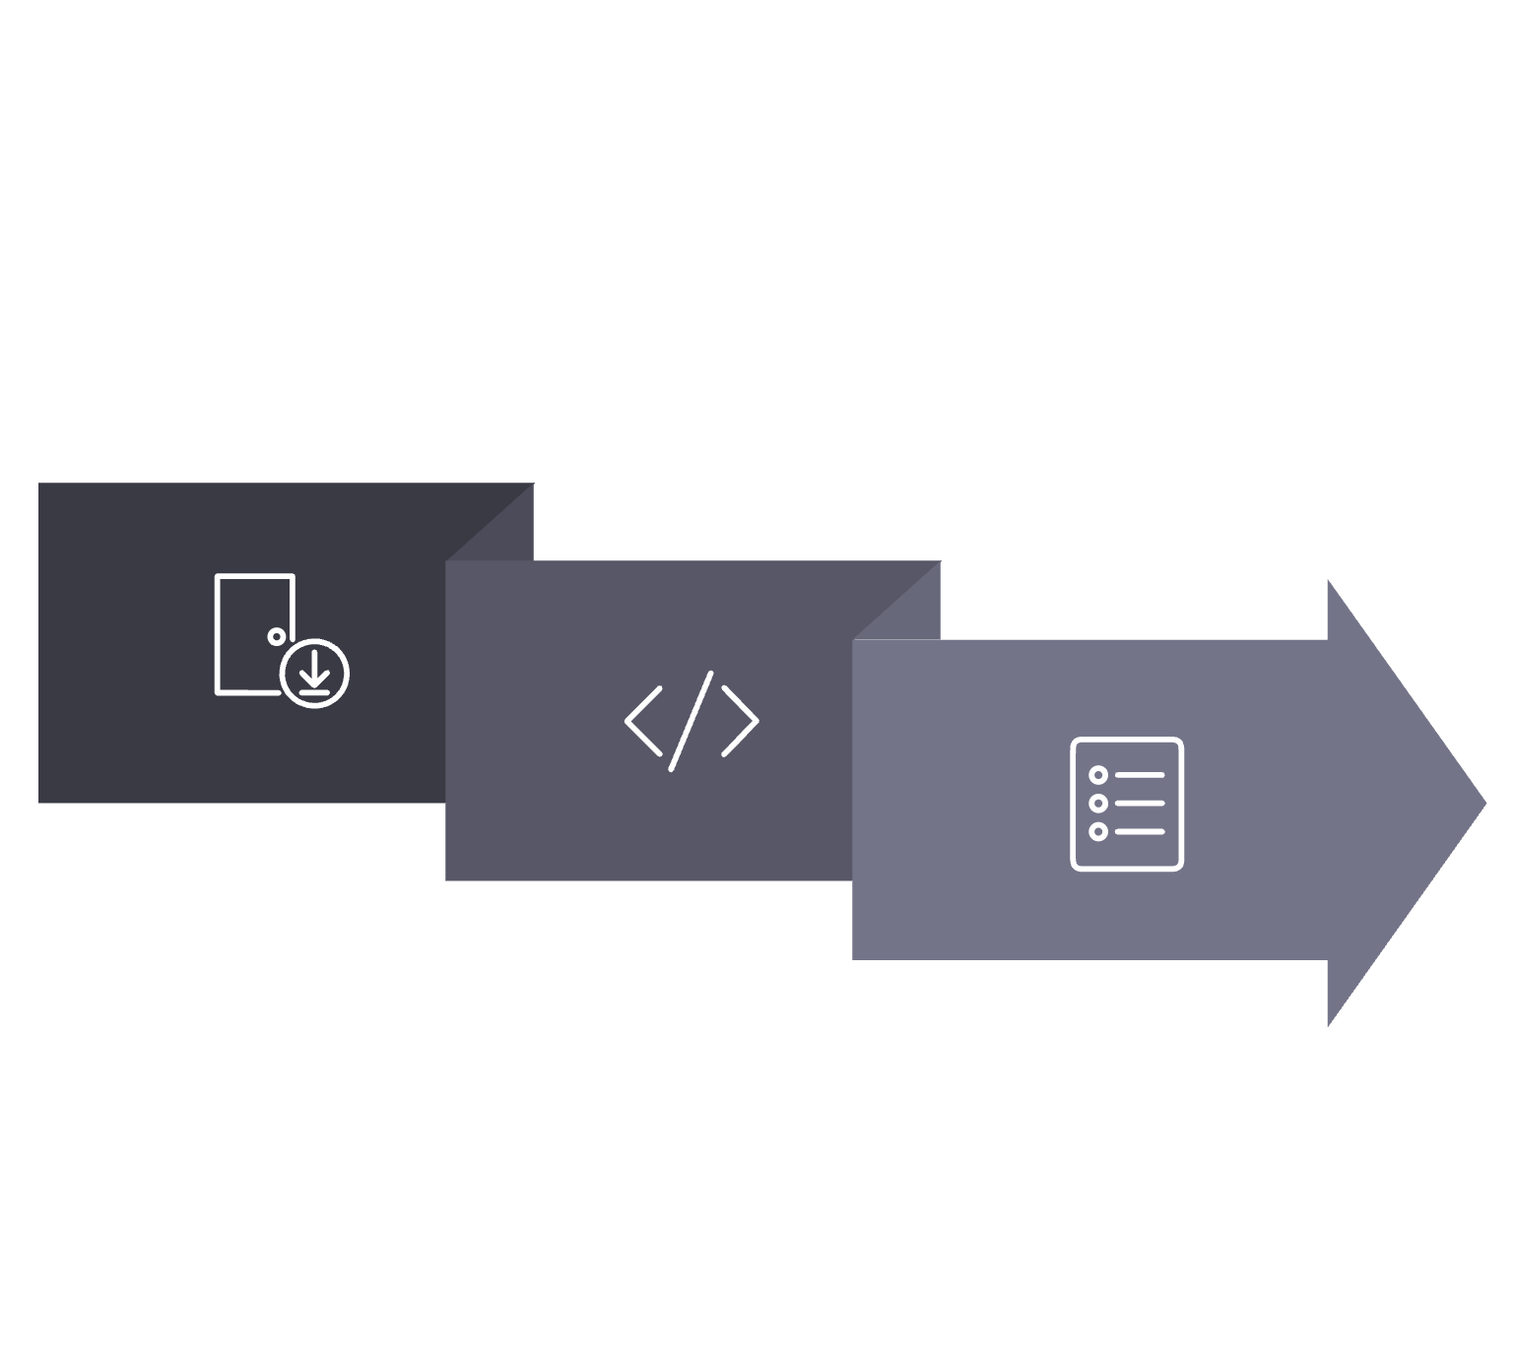
Breaking It Apart: split()
Splits a string into a list of substrings based on a separator.
Input String
Output List
Apply split()
Custom Separator
Default (Whitespace)
Use With Loops
"a,b,c".split(",")
→ ["a", "b", "c"]
"hello world".split()
→ ["hello", "world"]
Pairs perfectly with for loops to process each word or token individually.

Slide 9




Searching Strings: find()
Returns the index of the first occurrence of a substring within a string.
"banana".find("an") → 1
"banana".find("xyz") → -1
Found
Not Found
rfind()
Returns the starting index of the first match
Returns -1 — never raises an error
Use rfind() to search from the right side instead

Slide 10

Counting Occurrences: count()
How It Works
Returns how many times a substring appears in a string.
"banana".count("a") → 3
"banana".count("a", 2) → 2
"banana".count("a", 2, 5) → 1
Accepts optional start and end index arguments to limit the search range.
Non-overlapping matches only — "aaa".count("aa") returns 1, not 2.
3
2
"a" in "banana"
"an" in "banana"
"banana".count("a")
"banana".count("an")

Slide 11





Putting It All Together
Chaining methods transforms messy input into clean, usable data — one step at a time.
Input
" Hello, World! "
.strip()
"Hello, World!" — whitespace removed
.lower()
"hello, world!" — all lowercase
.replace(",", "")
"hello world!" — comma removed
.split()
["hello", "world!"] — split into a list

Slide 12
Quick Reference: String Methods Cheat Sheet
Method
Example
What It Does
strip()
" hi ".strip()
Remove leading & trailing whitespace
upper()
"hi".upper()
Convert to UPPERCASE
lower()
"HI".lower()
Convert to lowercase
title()
"hi there".title()
Capitalize Each Word
replace(old, new)
"cats".replace("c","b")
Swap substrings throughout
split(sep)
"a,b".split(",")
Break string into a list
find(sub)
"banana".find("an")
Locate substring, returns index or -1
count(sub)
"banana".count("a")
Count how many times sub appears

